Slide 1


Data
Analytics

Slide 2


Today's agenda
Project Recap
To provide a high-level overview of the business problem . We are tackling and the precise requirements, we will provide a summery of the entire project.
Problem
We will get into the particular issue that the Data Analytics team has been concentrating on and provide some context for why this such a significant issue.
The Analytics Team
I will start by outlining the issue a and then discuss the team that is in charge of handing this assignment on our end.
Process
After that I will go into the general steps we took to do this assignment so you can fully understand how we approach tasks of this nature..
Insights & Summery
Lastly, I will review all significant findings and offer them as a collection of understanding and illustrations from our approach.

Slide 3

Social Buzz is a rapidly expanding unicorn in the technology space that needs to quicky adjust to its global reach.
Accenture has started working on the following activities during a three-month POC:
An examination of Social Buzz’s use of big data
Strategies for a prosperous initial public offering
An examination to determine the top 5 content categories on Social Buzz.
Project Recap

Slide 4

Problem
In recent years, the customer has grown to an enormous extent, and they lack the internal resources to manage it
Every day, Social Buzz receives over 1,00,000 posts totaling 36,500.000 posts annually. Since all of the content is unstructured , it might be challenging to make sense of it all.
Combining tables from the sample dataset.
An analysis of their content categories that identifies the top five with the highest total population

Slide 5


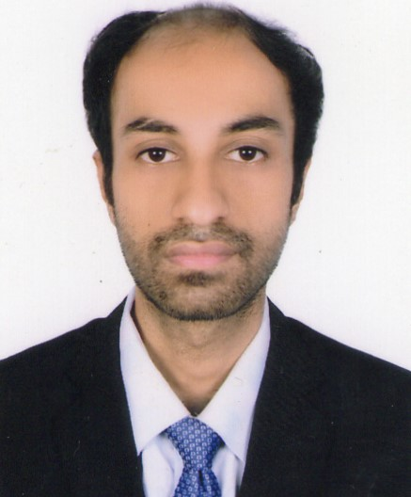
Andrew Fleming
Chief Technical Architect
The Analytics team
Marcus Rampton
Senior Principle
Arghadeep Sarker
Data Analyst

Slide 6
Understanding Data
Process
1
Data Cleaning
2
3
Data Modelling
4
Data Analysis
5
Data Insight

Slide 7

Insights
Unique Categories
Category With Highest Score Animals
Month with Most Posts
16
75K
MAY

Slide 10

Analysis
Animal and Science are two of the popular content categories, this shows that people enjoy real life and factual content the most. So, I would recommend that you keep creating more contents relating to these two categories
In Sight
Summary
Food is a common theme with the top 5 categories with “ Healthy eating” ranking as one of the highest . This may give an indication to the audience with your user base. You could use this insight to create a campaign and work with healthy eating brands to boost your engagement.
Next Steps
It should come as no surprise that technologies content is among the top categories. Given the advancement of technology. Working with some of the biggest digital campaign in the world is something I would suggest doing because it undoubtedly increase user engagement..

Slide 11
Thank you!
ANY QUESTIONS?

